Slide 1
Agile in AxS: TDD with JUnit and Maven
July-2009
Luu Vo

Slide 2
Agenda
Unit Test Overview
Possible Test Processes
Test Driven Development
Development Cycle
Benefits
TDD Stages
Unit Testing in AxS and Related Supporting Tools
JUnit Overview
Maven Overview
Demo
Summary
QnA

Slide 3
Unit Test Overview
Unit test: a test of a small functional piece of code
Frameworks:
  JUnit, NUnit, CppUnit, DUnit, VBUnit, RUnit, PyUnit, Sunit, HtmlUnit, …
  http://www.xprogramming.com/software

Slide 4
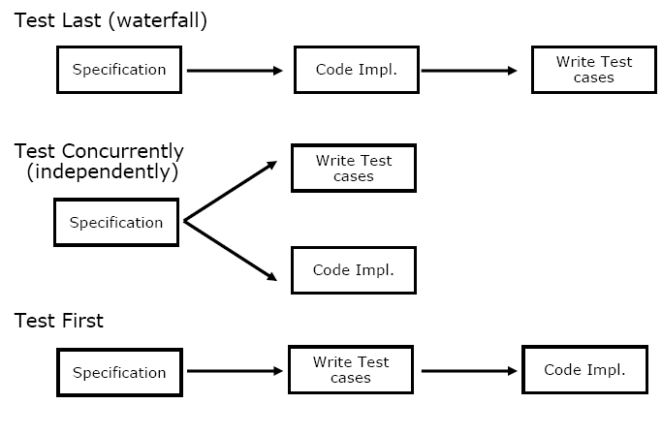
Possible Test Processes

Slide 5
Test Driven Development (TDD)
Quick overview:
  Agile
    eXtreme Programming (XP)
      Test Driven Development (TDD)
Agile: a conceptual framework generally centered on iterative and incremental delivery of working software, driven by the customer. Several agile methods exist:
  eXtreme Programming
  Scrum,
  Feature-Driven Development (FDD)
  Etc.
XP: Emphasize the values of communication, simplicity, feedback, and courage; use specific technical and collaborative practices, including TDD, refactoring, pair programming, continuous integration, open workspace, and automated acceptance tests

Slide 6
Test Driven Development (Cont.)
Test Driven Development is the craft of producing automated tests for production code, and using that process to drive design and programming
For every bit of functionality, you first develop a test that specifies and validates what the code will do.
You then produce exactly as much code as necessary to pass the test. Then you refactor (simplify and clarify) both production code and test code

Slide 7
Test Driven Development (Cont.)
Make it Fail
  No code without a failing test
Make it Work
  As simply as possible
Make it Better
  Refactor

Slide 8
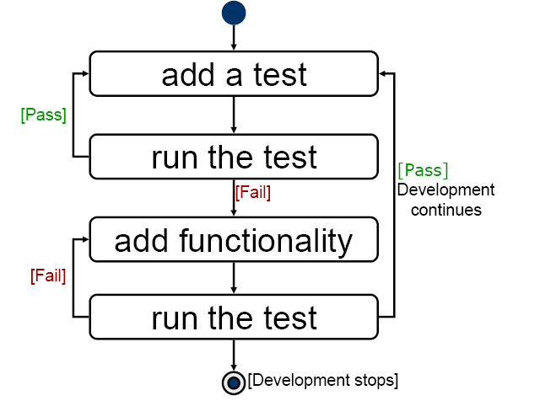
Development Cycle

Slide 9
Benefits
Efficiency
  Identify defects earlier
  Identify cause more easily
Higher value of test effort
  Producing a more reliable system
  Improve quality of testing (maintain automated tests)
  Minimization of schedule
  Stable code base

Slide 10
TDD Stages
Write a single test
Compile it. It shouldn’t compile because you’ve not written the implementation code
Implement just enough code to get the test to compile
Run the test and see it fail
Implement just enough code to get the test to pass
Run the test and see it pass
Refactor for clarity and “once and only once”
Repeat

Slide 11
Unit Testing in AxS and Related Supporting Tools
Maven 2.0.9: build, execute tests, package, test coverage report (maven with appropriate plugins)
JUnit 3.8.1: unit test framework
Eclipse 3.4: IDE – free http://www.eclipse.org/
Continuous Integration: Bamboo (commercial, http://www.atlassian.com/software/bamboo/
Project management, tracking & documentation:
  Jira (commercial, http://www.atlassian.com/software/jira/ )
  Confluence – wiki (commercial, http://www.atlassian.com/software/confluence/ )
Source control: Subversion 1.5.6, GUI: TortoiseSVN 1.5.9 (free)
Code review: FishEye + Crucible (commercial, http://www.atlassian.com/software/fisheye/ http://www.atlassian.com/software/crucible/ )
Test coverage: mainly server side (client/GUI side tested manually)

Slide 12
JUnit Overview
A simple framework for writing and running automated tests for Java programming language (free, open source)
  http://www.junit.org/
Latest version: 4.7
  http://sourceforge.net/projects/junit/
Getting started guide:
  http://junit.sourceforge.net/

Slide 13
Maven Overview
Tool for building and managing Java-based projects (Apache Software License)
  http://maven.apache.org/
Support Windows, Linux, Solaris and Mac OS X
Latest version: 2.2.0 available at
  http://maven.apache.org/download.html
Getting started guide
  http://maven.apache.org/guides/getting-started/index.html

Slide 14
Demo
Demo
  mvn archetype:create -DarchetypeGroupId=org.apache.maven.archetypes -DgroupId=com.mycompany.app -DartifactId=my-app
  mvn compile
  mvn test-compile
  mvn test
  mvn package
  mvn install
  mvn clean
  mvn eclipse:eclipse
  mvn site:site

Slide 15
Summary
TDD
=
Test first
+
Automated (Unit) Testing
RED
GREEN
REFACTOR
GREEN

Slide 16
QnA
Thanks for your attention and questions

